Slide 1
Intro to Circuits
Sean Murphy
Tampa Hackerspace
http://goo.gl/e97Eep

Slide 2
Water Analogy
Electricity is like water flowing through a series of pipes and other elements (like pumps et al.)
Electricity is actually energy from the build-up or movement of charges (usually electrons)

Slide 3
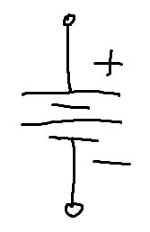
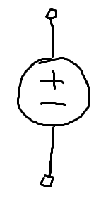
Voltage – the potential to move charge
Water pressure – Volts (V)
Voltage is the capability to produce current (flow)
A battery is a constant-pressure pump

Slide 4
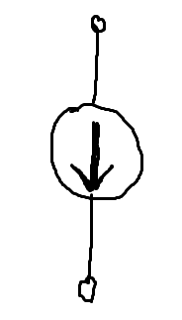
Current – the flow of charge
Water flow – Amperes (Amps) (A)
Current will only flow when there is a voltage (pressure) and a non-restricted path
A battery provides current when a load is connected across it

Slide 5
Power – the expenditure of energy
Pressure*flow
P=V*I
Watts (W)
Power of a component is equal to the product of current through the component and the voltage drop across the component

Slide 6
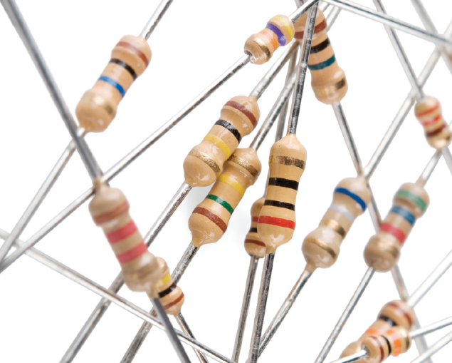

Resistance
A small diameter pipe will require a higher pressure to produce the same flow as in a large pipe. There will be a lower pressure at the output compared to the input.
Resistance is the proportion of voltage to current. V=I*R (Ohm’s Law)
Ohms (Ω)

Slide 7
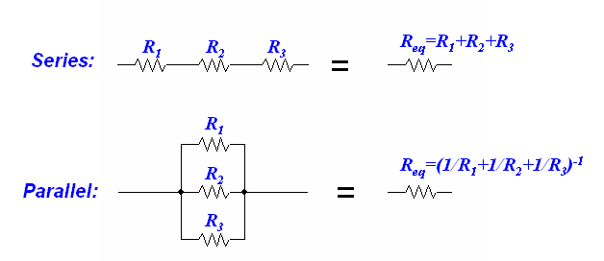
Adding Resistance

Slide 8
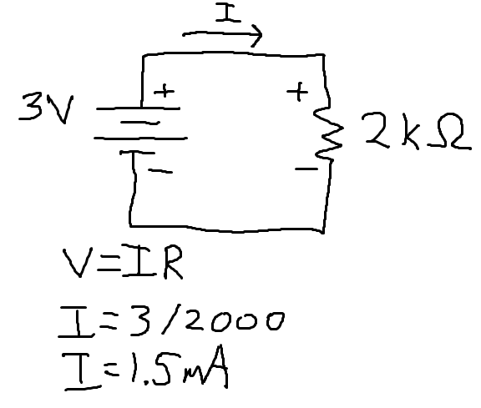
The simplest of circuits

Slide 9
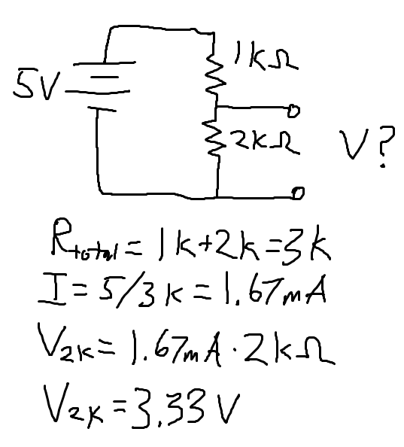
Voltage Divider

Slide 10
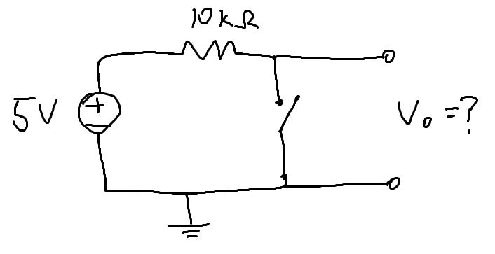
Pullup Resistors

Slide 11
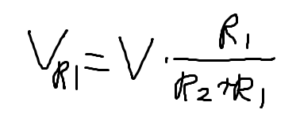
Generic case
Used for simply stepping down voltage
Be careful, this assumes that no current comes out of the center node

Slide 12
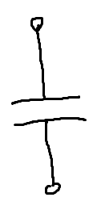
Capacitance
A water balloon on a pipe will inflate to match the pressure of the pipe then expel its contents when external pressure is reduced.
A capacitor holds an electrical charge and provides or accepts current to maintain a potential
Farads (F) F=A*s/V

Slide 13
Adding Capacitance
Opposite of resistors
Parallel is the sum of individual capacitors
Series is the reciprocal of the sum of reciprocals

Slide 14
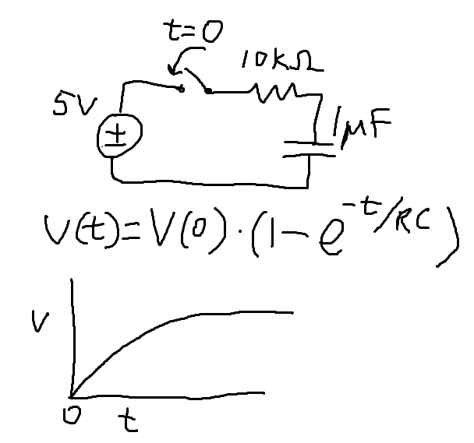
Nothing else is simple

Slide 15
What you need to know about C
Capacitors are used to filter high frequency from low frequency (or Direct Current (DC))
They smooth out fast changes
When dealing with Alternating Current (AC), a capacitor has a reactance X=1/(2πf*C)
So, a high frequencies, capacitors act small resistors, and the smaller the capacitor, the larger the equivalent resistance

Slide 16
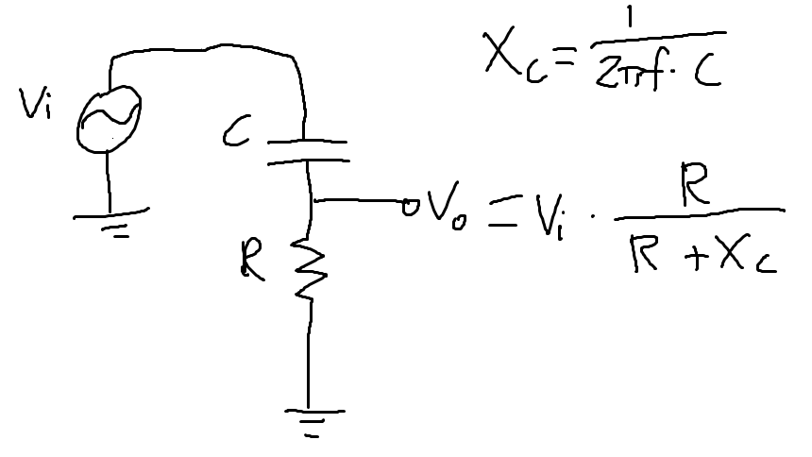
High pass filter

Slide 17

Inductors
Think of a waterwheel. It will store energy if there is flow then attempt to continue the flow by making a backpressure if external pressure is removed.
Henries (H)
Like capacitors fight changes in voltage, inductors fight changes in current
X=2πf*L

Slide 18
Uses of Inductors
Switching power supplies
Power supply filtering
Transformers (coupled inductors)

Slide 19
Diodes
One way gates for current
Open circuit in reverse direction
Constant 0.7V drop in forward direction (major simplification)

Slide 20
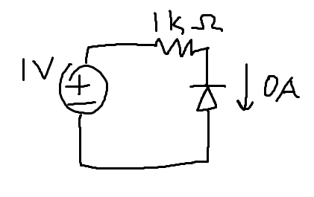
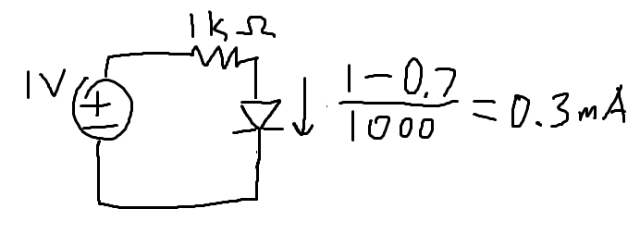
Examples

Slide 21
LEDs
Light Emitting Diodes
Behave a lot like standard diodes
Voltage drop is dependent on type of LED
1.5V to 4V drop typical (check datasheet)
Typically pass 20mA at forward voltage

Slide 22
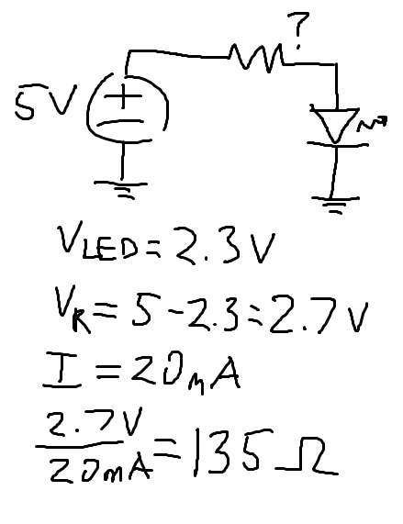
Current-limiting an LED

Slide 23
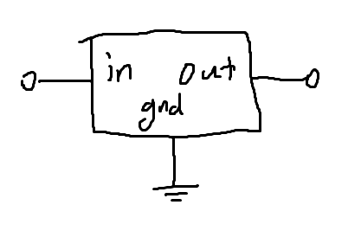
Voltage Regulators
Output a constant, fixed voltage from an input voltage (usually higher)
Used as power supplies
TL7805 for example provides 5V regulated output
Essentially a self-varying
resistor

Slide 24
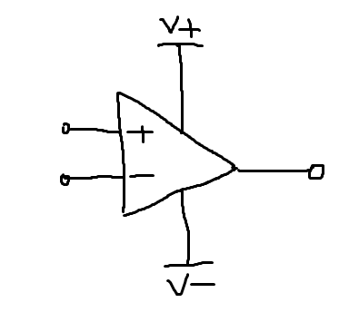
Op-Amps
Operational Amplifiers take an input voltage and amplify it for a larger output voltage
This is a class onto itself

Slide 25
Relays
Electrically actuated switches
Useful for switching AC and high currents
Slow and wasteful

Slide 26
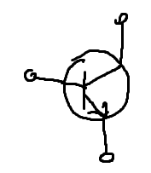
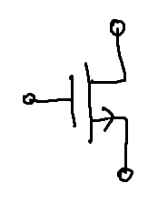
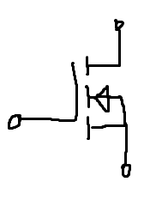
Transistors
BJTs and MOSFETs
Electrically actuated switches
Also used as amplifiers
The fundamental component of the computer revolution

Slide 27
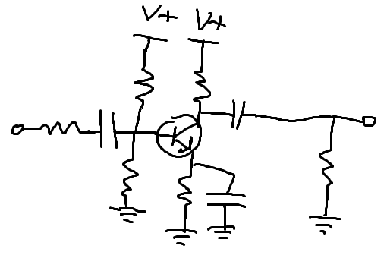
Transistor Application Circuits

